Slide 2
Agenda
Motivations for Modern Architectures
Trend from 3D to 4D Architecture
The 4th Dimension is Change
Autonomy allows for Change
Approaches and Frameworks
Spring and Related Frameworks
Autonomous Business Services
Steps to Fine-grained Autonomy
Examples
How Pivotal helps Enterprises Transform
Application Infrastructure ( Spring and Cloud Foundry)
Labs (Agile, DevOps, Data Science)
MPP Analytics (Greenplum, Hadoop, and Hawq)

Slide 3
Motivations

Slide 4
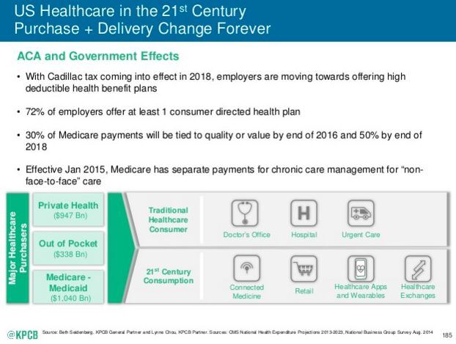
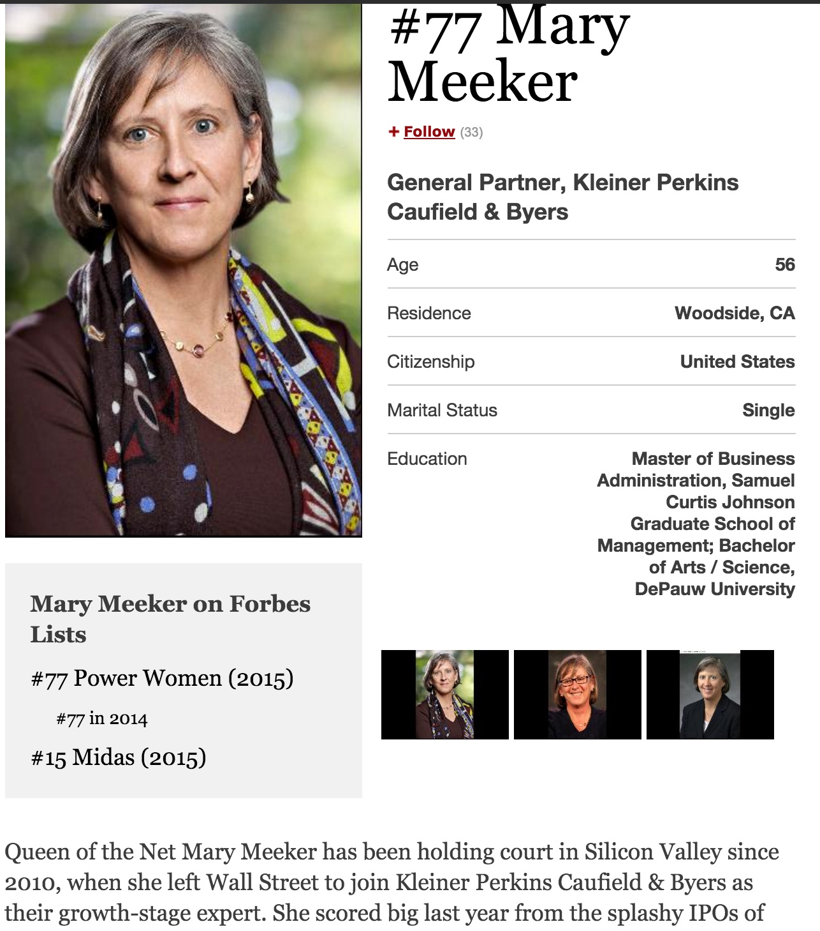
Notes:
http://www.kpcb.com/internet-trends
Look for Gartner Slide on Dev Trends
State of the Web Reports

Slide 5
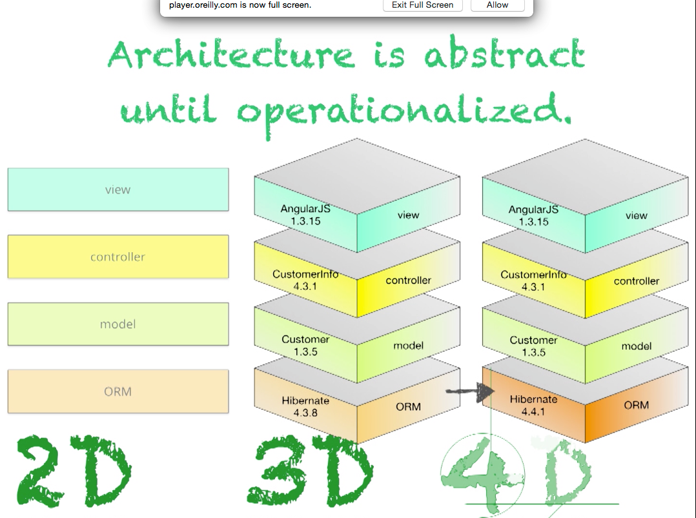
Moving from 3D to 4D
By Neal Ford
Notes:
https://player.oreilly.com/videos/9781491932636

Slide 6

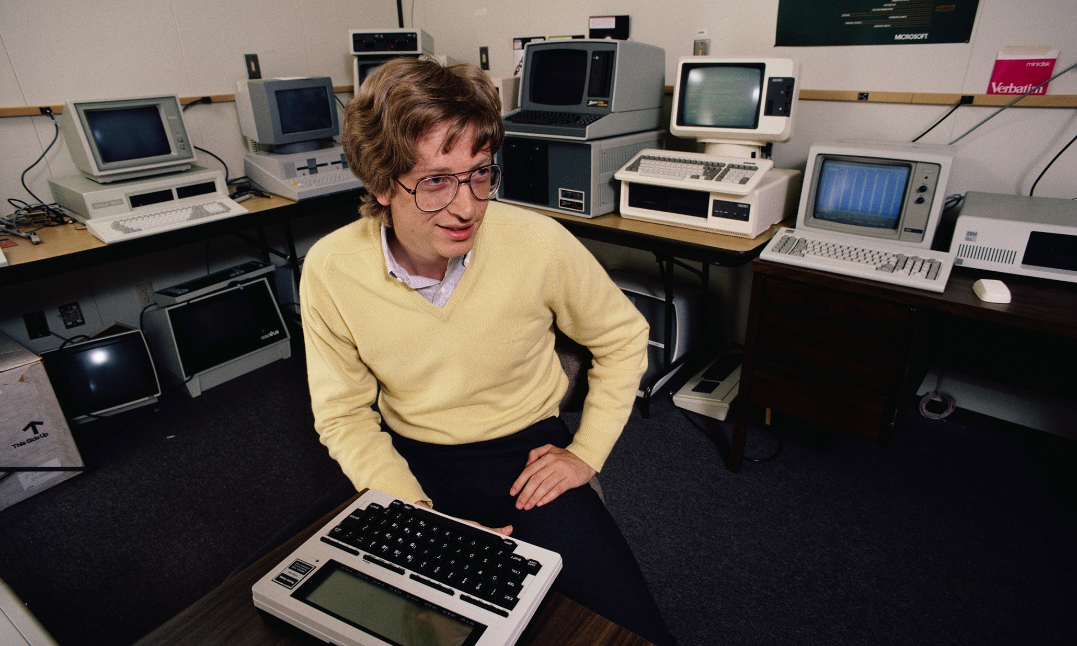
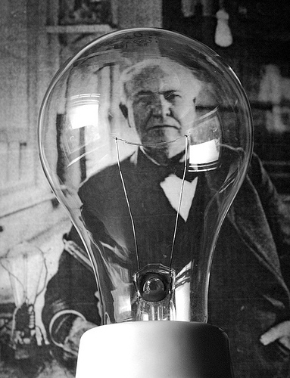

Engineering Focus …..always changes
Mass Production + Assembly Line
Software + PCs
Apps + Phone
Electricity
+ Distribution
Notes:
PC revolution
Assembly line
Smart phone and integrated mobile platform with “apps”
Electricity + distribution

Slide 7
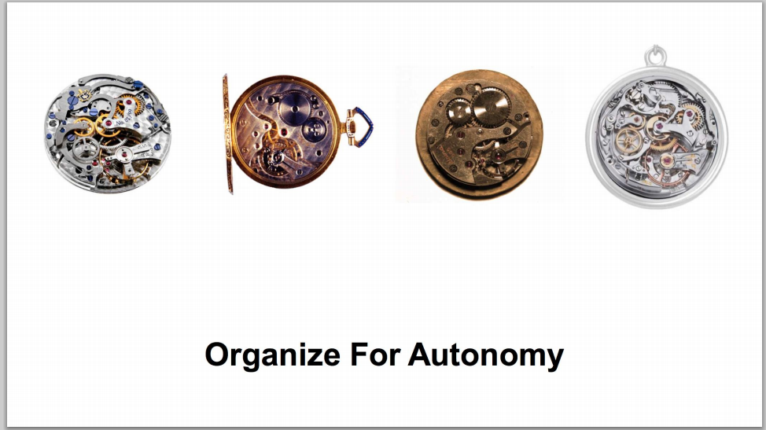
New 4D Focus: Accelerate Innovation
Lowers Cost of Failure
Reduces Friction
Speeds Iteration
High Frequency of Deployment
The right org/size, api contracts, & expectations
Amazon Summit 2014
Notes:
http://media.amazonwebservices.com/jp/summit2014/TE-01.pdf
Add conways law and inverse conway maneuver

Slide 8
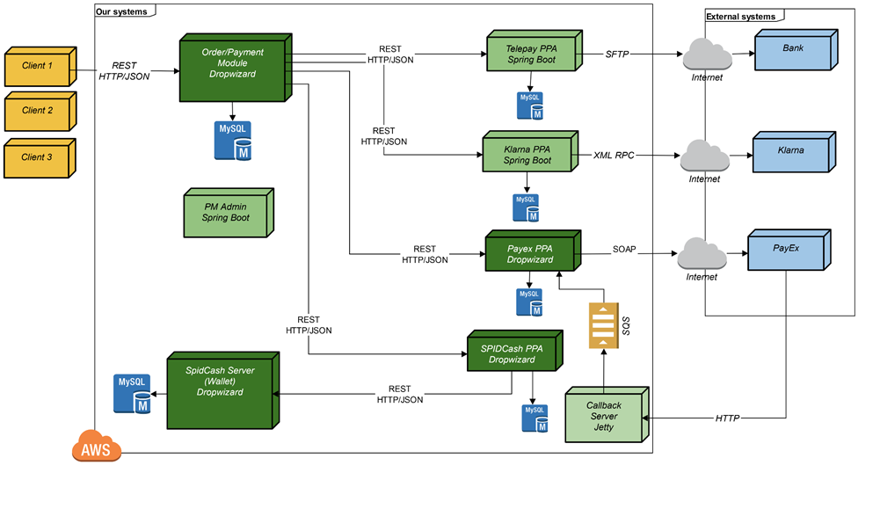
Architecture built for Autonomous Change
Comparison of Spring and Dropwizard - 2015
Notes:
http://www.schibsted.pl/2015/07/spring-boot-and-dropwizard-in-microservices-development/

Slide 9
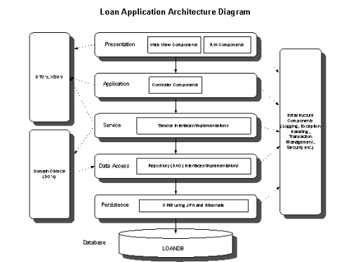
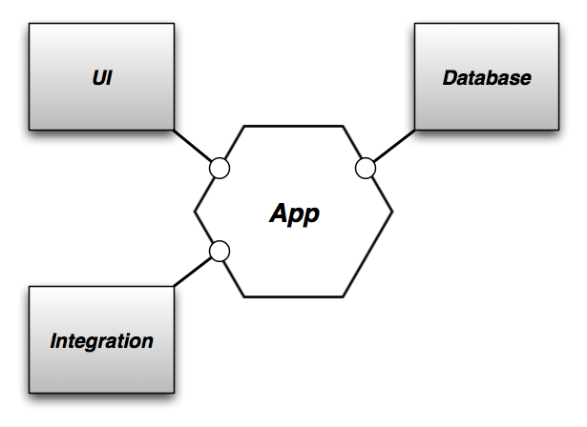
“Life Preserver” Rather than a “Raft”
Hexagonal Architecture by Alistair Cockburn - 2005

Slide 10
List of Avenues Opened up by Autonomy
Blue- Green Deployment
Polyglot Persistence and use of other new or special-purpose technologies
Multi-Cloud Hosting
Independent Scaling
Anti-Fragility Patterns (Circuit-breaker, etc.)
Testing in Production (multiple, simultaneous versioning)

Slide 11
Approaches

Slide 12
Recommended Code Frameworks
Spring for Java
Spring Boot
Spring Data
Spring Security
Spring Integration
SpringXD
Cloud Foundry for IAAS
CF CLI
Loggregator
Buildpacks
Service Provisioning
Spring Cloud:
Data Flow
Security
Services
Netflix OSS for REST API’s
Zuul
Eureka
Hystrix
Turbine
Ribbon

Slide 13

Autonomous Business Service
Provisioning/Scaling, Monitoring, Logging
RESTful API
Spring Boot
Spring Core
Spring Data [-REST]
Spring Integration
Spring XD
Real-time Events (Pub-Sub, Batch)
Index.html
Caching, Persistence, ORM
Downstream Services

Slide 14
Evolving to fine-grained autonomy
Monolith
Micro- Monolith
Micro-Service
Gateway
UI Composition
N-tiered Composition
Circuit- Breaker
Spring Boot
Spring Core
Spring Data [-REST]
Spring Integration
Spring Batch

Slide 15
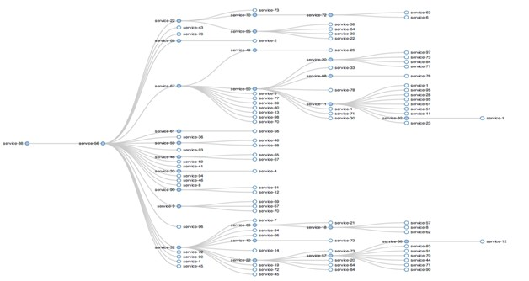
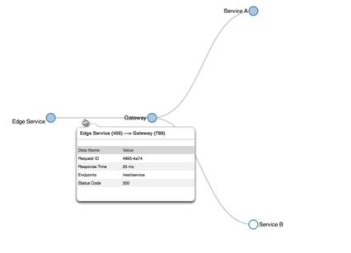
Visualization of Autonomous Service Network
Netflix Presentation by Sudir Tonse 2014
Notes:
http://player.slideplayer.com/17/5279417/#
This is a good place to talk about how architecture and organization gain synergies around the fine grained approach:
Teams are small and code bases are easy to learn which help with turnover and

Slide 16
Application Service View
A view of how Application Services and other components interact
Reference Architecture:
Restful MicroServices
Recommended Frameworks:
Spring Boot
Spring Cloud
Spring Cloud Config
Spring Cloud Netflix / Apigee
Spring Cloud Bus /RabbitMQ
Spring Data REST
Spring Integration
Spring Security (OAUTH or SAML)
Vaadin (CRUD UI) / AngularJS
MVC UI or 3rd party
Client
Layer
Request Routing / Security / API Mgmt /Circuitbreaker
Svc
Svc
Asynch Channel
Svc
Restful Svc
Data Store
Data Store
Polyglot Persistence
Layer

Slide 17
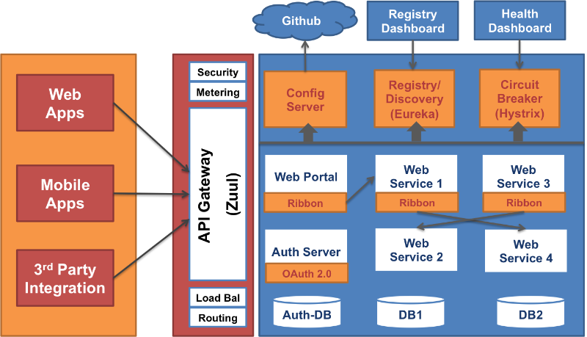
Example
Example by Anil Allewar (Synerzip) 2015
Notes:
https://www.linkedin.com/pulse/microservices-reference-architecture-spring-boot-cloud-anil-allewar
Do some bashing of microservices (you must be this tall to use Microservices) to tee up PCF
Find out about Synerzip
Find out what Humana’s architecture is (if its similar)

Slide 18
Security View
A view of Authentication and Authorization
Limited Surface Area for Attack (DMZ, Security Groups, Egress rules etc.)
Client requires Credentials
Reference Architecture:
Restful MicroServices
Recommended Frameworks:
Spring Boot
Spring Cloud
Spring Cloud Config
Spring Cloud Netflix
Spring Cloud Bus
Spring Cloud Security(OAUTH or SAML)
Spring Data REST
Spring Security (Business Service Level)
AngularJs
Container requires Credentials (LDAP lookup or Token Validation)
& Authorization (Soring Cloud Sec)
LDAP, AD,
Token Svr
Leverage Java-based Method-level security (Spring Security)
Leverage Database-Level
Security
Authorization Server
Notes:
Look at Spring Security and base our story on that

Slide 19
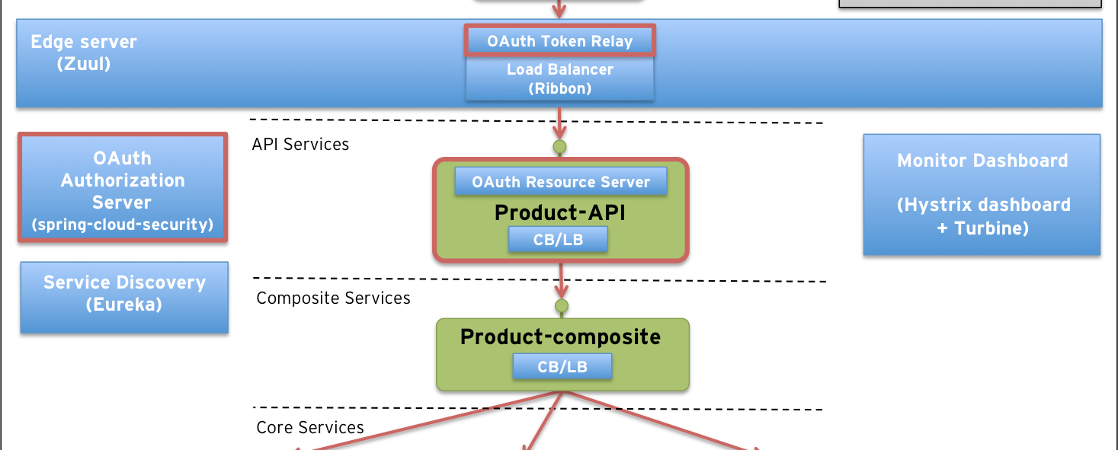
Example: API gateway view /Security

Slide 20
Big Data / Analytics View
A view of Big Data and Analytics will be supported
Reference Architecture:
Lambda
Recommended Frameworks:
ODP compliant HDFS
HAWQ for Query
MADLib for Machine Learning
SpringXD for Stream processing
Greenplum for Batch Views
Gemfire/Redis for Serving Layer
Data Lake
Batch
Layer
Indep. Bus. Service
Batch Views
Raw Data from Sources
RT Events
Stream Processing
Stream
Layer
Notes:
Add something here to support the idea of Kafka and Reactor?

Slide 21
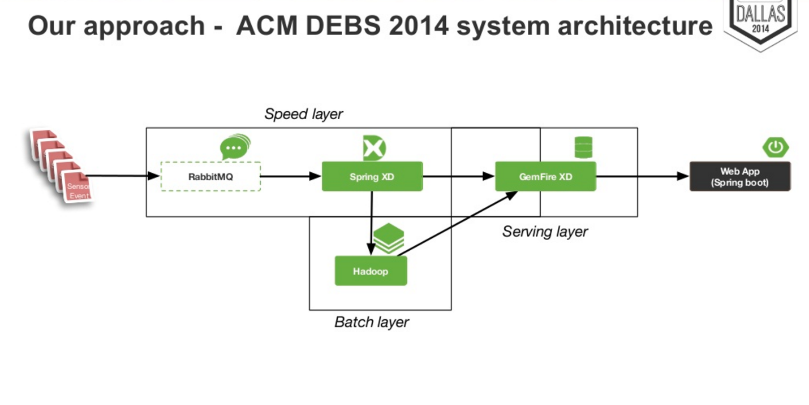
Notes:
http://www.slideshare.net/SpringCentral/spring-one2gx-2014carlosqueiroz

Slide 22
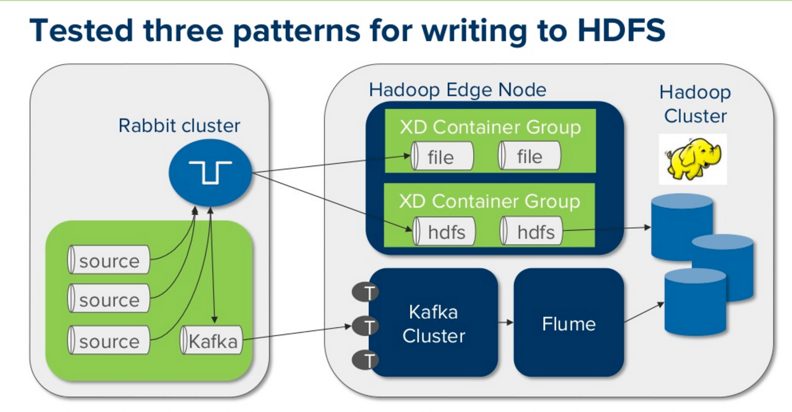
Kafka / Event view
Etrade Example by 2015
Notes:
ETRADE video https://www.youtube.com/watch?v=MZIPf9OipmE
“IntegrationConversionService”
RL view of integration with rabbitMQ
http://www.slideshare.net/SpringCentral/supercharging-operations-analysis-using-spring-xd-to-support-analytics-and-cep

Slide 23
Pivotal

Slide 24
Pivotal Areas of Focus
Cloud Native Platform
Learn and Change Quickly
Combine Apps and Data
Leverage Cloud Agility
Data Science
Multiple Industries
Combine Data, Apps, and Methodology
Continual Innovation
Pivotal Labs
Test-Driven Development
Pair Programming
12-Factor Apps
Cloud Native Platforms
Dev-Ops

Slide 25


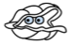



Culture
Platform
Tools
Application Framework
Dev
Spring Cloud
Spring Boot
Runtime Platform
Dev
IT Ops
Cloud Foundry
Infrastructure Automation
IT Ops
BOSH
Infrastructure
IT Ops
AWS
VMWare
Azure
OpenStack
Notes:
Pivotal breaks down cloud native technology into 3 layers, which is all supported, reinforced and optimized by cloud native culture and Tools
This may seem a lot to take initially, so lets break it down later by layer.
Starting at the top - But before we do, lets talk about Developers

Slide 26

Platform Runtime
Services
Routing
Container Scheduling
Service Discovery
Configuration
Database
Application Framework
Big Data
12 Factor Apps
Microservices
RESTful Services
Circuit Breakers
Object Storage
Mobile
Spring Boot
Ruby on Rails
Node.js
.NET
Build CI
Logging & Metrics
Messaging
User Provided
Operations
Zero Downtime Deployments
Failover & Recovery
Scaling
Security Patching
Platform
Upgrades
Infrastructure
VMware
OpenStack
Amazon
Notes:
Dev and Ops teams have to change together
Our customer base was struggling with partial transitions and continuous delivery
What’s the alternative to an integrated cloud native solution?
Spring Boot is bringing microservices to the Java enterprise
Pivotal Cloud Foundry is how your deploy Spring Boot applications.
Would you rather have developers spend their time building a platform, or using one?
It’s what some enterprises are doing today: adopting cloud a-la-carte today, using a combination of individual cloud services or technologies: Just EC2 + services. Just Docker. Docker with Puppet/Chef/Ansible/SALT. MesosSphere or Kubernetes with Docker on EC2. etc etc.
Non-native, unintegrated approaches don’t offer the economy of scale inherent in a cloud native approach – partial approaches miss the mark. Most enterprises are considering to deploy multiple cloud applications, and would save $$$ if the process was repeatable – which you don’t get from using point solutions.
Partial adoption places your efforts at the mercy of “Day 2” adoption issues – rife throughout the various, unintegrated layers of a cloud native solution. The next app is almost certain to require a different set of choices and trade-offs, so any economy of scale from the last effort goes out the window.
Cloud native apps build on a repeatable, structured approach to the app framework, the elastic runtime and the infrastructure automation. Why reinvent things for every project?
12 factor app development and architecture, cloud resource connectivity
Security
Container Automation (create/scale more containers)
IDM
Log and metrics aggregation
APM
Etc etc

Slide 27
Platform with Apps + Data
Sources
Ingestion Tier
Serving Tier
Insights Tier
Action Tier
System monitoring
API management
Autonomous Svc
Real-time ingestion
Real-time
Real-time insights
Data Services
Tasks
Process Steps
REST/Java services
Workflow management Svc
Events
Micro batch ingestion
Micro batch
Event Management Svc
Interactive insights
In-memory Caching
SQL
Operational Database
Batch ingestion
Mega batch
Batch insights
Distillation Tier
SQL
MapReduce
MPP/Hadoop Database
Unstructured and structured data

